Slide 1
6 Ways to Prevent Code Abuse
Michael L Perry

Slide 2



Michael L Perry
qedcode.com
@MichaelLPerry
https://github.com/michaellperry/ Provable-APIs

Slide 3
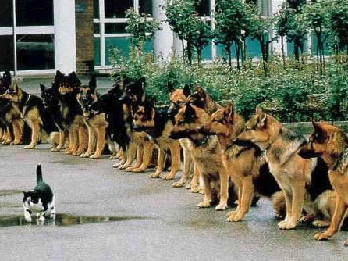
Confidence
Notes:
http://www.globalnerdy.com/2007/02/06/living-dangerously-with-vista-itunes-and-the-ipod/

Slide 4
Ways to Gain Confidence
Manual Testing
Code Reviews
Unit Testing
Quality Metrics
Continuous Integration

Slide 5
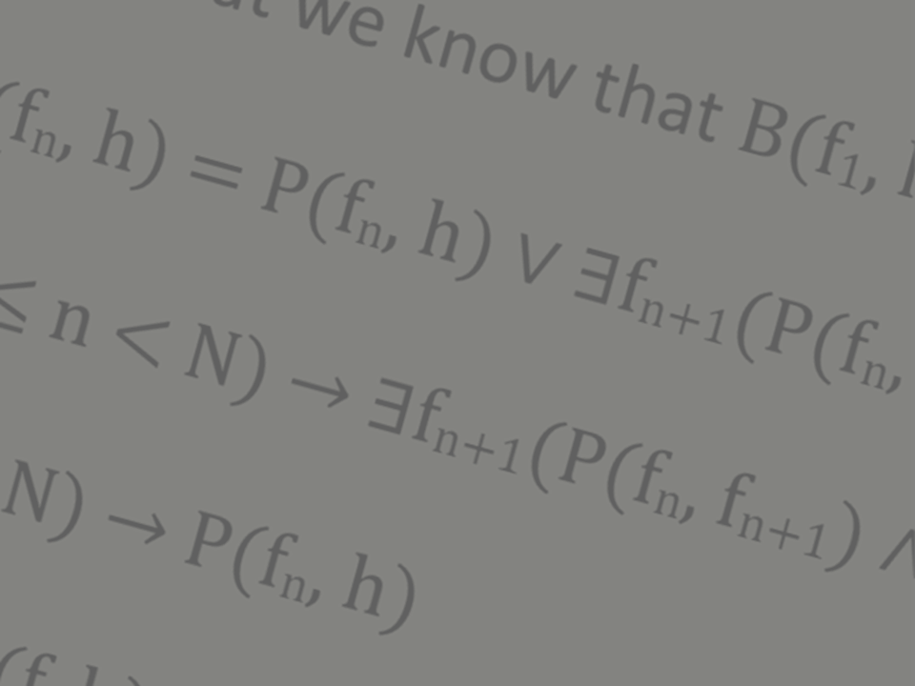
Mathematical Proof

Slide 6
Prevent Code Abuse
APIs are intended for others to call
Their problem becomes yours
You cannot test their work
Guide others to correct use

Slide 7
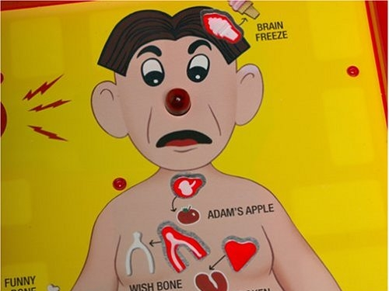
Exceptions
Notes:
http://aroundthesphere.wordpress.com/2009/07/14/organs-urgency-money-and-reform/

Slide 8
Make it impossible
Parameters
Callbacks
Factories
Constructors
Immutability
Monads

Slide 9
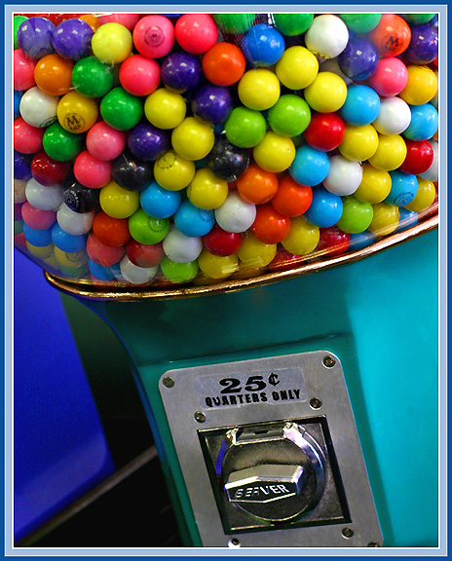
Parameters
Notes:
http://michaelweinberg.com/5new-hitparade1.html

Slide 10
One thing must be done before something else

Slide 11
YourAPI yourApi = new YourAPI();
yourApi.DoThisFirst();
yourApi.DoThisSecond();

Slide 12
YourAPI yourApi = new YourAPI();
var result = yourApi.DoThisFirst();
yourApi.DoThisSecond(result);

Slide 13

Callbacks
Notes:
http://www.visitingdc.com/city/hollywood-sign-address.asp

Slide 14
Something is done between two functions

Slide 15
YourAPI yourApi = new YourAPI();
yourApi.DoThisFirst();
DoThisInTheMiddle();
yourApi.DoThisLast();

Slide 16
YourAPI yourApi = new YourAPI();
yourApi.DoThis(delegate
{
DoThisInTheMiddle();
});

Slide 17

Constructors
Notes:
http://www.virtualworldlets.net/Resources/Hosted/Resource.php?Name=Lightcycles
Copyright Walt Disney

Slide 18
Something is done once and only once

Slide 19
YourAPI yourApi = new YourAPI();
yourApi.DoThisOnce("value");
yourApi.DoThisRepeatedly();
yourApi.DoThisRepeatedly();

Slide 20
YourAPI yourApi =
new YourAPI("value");
yourApi.DoThisRepeatedly();
yourApi.DoThisRepeatedly();

Slide 21
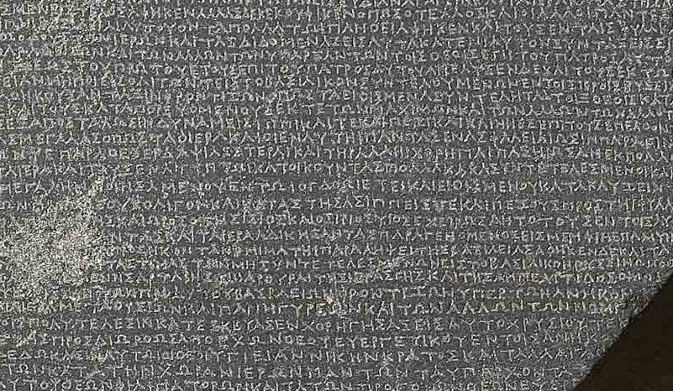
Immutability

Slide 22
Nothing has changed in the interim

Slide 23
YourAPI yourApi = new YourAPI();
yourApi.SetThis = "value";
yourApi.UseIt();
yourApi.ExpectItToBeTheSame();

Slide 24
YourAPI yourApi =
new YourAPI("value");
yourApi.UseIt();
yourApi.ExpectItToBeTheSame();

Slide 25

Factories

Slide 26
An argument meets a condition

Slide 27
YourAPI yourApi = new YourAPI();
YourObject obj = new YourObject();
obj.Property = "value";
if (obj.MeetsSomeCondition)
{
yourApi.Accept(obj);
}

Slide 28
YourAPI yourApi = new YourAPI();
var obj = YourObject
.GenerateValidObject("value");
yourApi.Accept(obj);

Slide 29
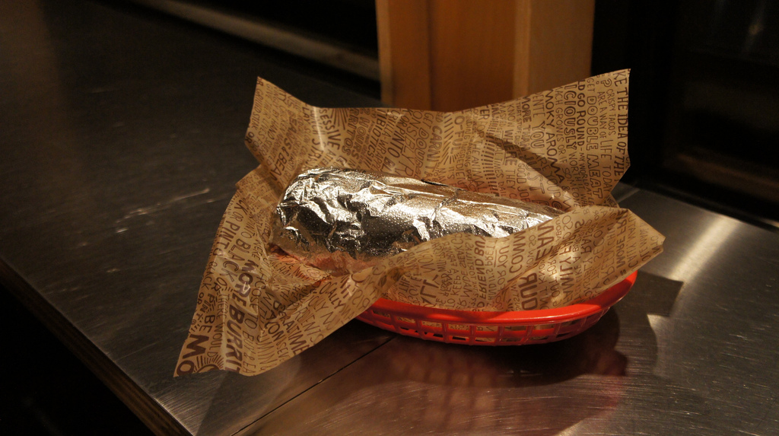
Monads
Notes:
https://www.flickr.com/photos/z0/5116389006
Bring the world of side-effects under the control of compositionality

Slide 30
Special cases are considered

Slide 31
YourAPI yourApi = new YourAPI();
if (!yourApi.Step1())
HandleCondition1();
try
{
var value = yourApi.GetValue();
ProcessValue(value);
}
catch (Exception ex)
{
HandleCondition2();
}

Slide 32
YourAPI.Begin()
.Bind(ProcessValue)
.OnCondition1(HandleCondition1)
.OnCondition2(HandleCondition2);

Slide 33
Methods of the Socket class
Socket(SocketInformation si);
Socket(AddressFamily af, SocketType st, ProtocolType pt);
Socket Accept();
void Bind(EndPoint local);
void Connect(EndPoint remote);
void Connect(string host, int port);
void Dispose();
void Listen(int backlog);
int Receive(byte[] buffer);
int Send(byte[] buffer);

Slide 34
Rules of the Socket class
You cannot use a Socket returned from Accept to accept any additional connections from the connection queue.
You cannot call Accept, Bind, Connect, Listen, Receive, or Send if the socket has been closed.
You must call Bind before you can call the Listen method.
You must call Listen before calling Accept.
Connect(string host, int port) can only be called if addressFamily is either InterNetwork or InterNetworkV6.
Connect cannot be called if Listen has been called.
You have to either call Connect or Accept before Sending and Receiving data.
If the socket has been previously disconnected, then you cannot use Connect to restore the connection.

Slide 35
Constructors
Parameters
Callbacks
Monads
Immutability
Factories

Slide 36

Paradox of Constraints

Slide 37
Michael L Perry
qedcode.com
@MichaelLPerry
https://github.com/michaellperry/ Provable-APIs

